Slide 1
AutoGeneration Of C code…
BY,
Anushka Londhe(RA2011003010463)
Jogeswar Panigrahi(RA2011003010470)

Slide 2
Introduction…
Converting a pseudo code given by the user to a working C code can be a challenging task, but it is an essential skill for any programmer. Pseudo code is a high-level description of a program's logic that is written in plain English or another natural language. It is used to plan out the structure and flow of a program before it is actually coded.
However, pseudo-code cannot be executed on a computer, so it must be translated into a programming language such as C. This process can be difficult, as it requires a deep understanding of both the pseudo code and the programming language. In this presentation, we will explore some tips and techniques for converting pseudo code to C code.

Slide 3
Steps for Conversion…
01
Understanding the Pseudo Code
02
Translating the Pseudo Code to C Code
03
Debugging the C Code
04
Optimizing the C Code

Slide 4
01
Understanding the Pseudo Code
The first step in converting pseudo code to C code is to fully understand the logic and structure of the pseudo-code. This involves breaking down the pseudo code into smaller parts and analyzing each part separately. It is important to identify the key variables, functions, and control structures used in the pseudo-code.
Once you have a clear understanding of the pseudo-code, you can begin to translate it into C code. This involves mapping each part of the pseudo-code to its corresponding C code construct. For example, if the pseudo code uses a loop to iterate over a set of data, you would use a for loop in the C code to achieve the same result.

Slide 5
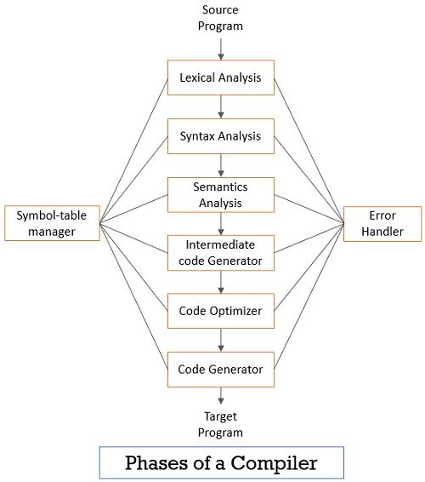

Slide 6
02
Translating the Pseudo Code to C Code
Translating the pseudo code to C code requires a deep understanding of the syntax and structure of the C programming language. You must also be familiar with the various data types, operators, and control structures used in C code. It is important to pay attention to details such as variable names, function calls, and indentation, as these can affect the functionality of the code.
One effective technique for translating pseudo code to C code is to write out the C code in small chunks, testing each chunk as you go. This allows you to catch errors early on and make adjustments as needed. It is also important to document your code as you go, using comments and descriptive variable names to make the code more readable and maintainable.

Slide 7
03
Debugging the C Code
Once you have translated the pseudo code to C code, it is important to test and debug the code to ensure that it functions correctly. This involves running the code through a series of tests and identifying any errors or bugs that may arise. Common debugging techniques include using print statements, stepping through the code line by line, and using a debugger tool.
It is also important to consider edge cases and potential errors that may occur during runtime. This includes handling input validation, error messages, and unexpected behavior. By thoroughly testing and debugging your C code, you can ensure that it is reliable and functional.

Slide 8
04
Optimizing the C Code
After you have tested and debugged your C code, you may want to optimize it for performance or efficiency. This involves analyzing the code for areas where it can be improved, such as reducing unnecessary calculations or memory usage. It is important to balance optimization with readability and maintainability, as overly complex code can be difficult to understand and modify.
Common optimization techniques include using efficient algorithms, minimizing memory usage, and reducing the number of function calls. By optimizing your C code, you can improve its speed and efficiency, making it more useful for large-scale applications.

Slide 9
Problem Statement
Given an algorithm or pseudocode as input, the automatic C-code generator converts the algorithm to its corresponding C code.

Slide 10
Functionalities available…
Declaring and initializing variables
Use of variables only if declared
Functions and procedures
Looping statements ( while,for ,do-while)
Operations: Arithmetic, logical, assignment, relational
Conditional statements
Reading input and printing output

Slide 11
Implementation…
This converter has been constructed using lex and yacc. The keywords/ tokens are declared in the lex file. The productions and rules for converting the algorithm to c code are implemented in yacc file.

Slide 12
Working…
The ‘lex’ command is used to generate a lexical analyzer or lexer from a ‘.l’ file that contains a set of regular expressions and corresponding actions. Here are the steps to use ‘lex’ to generate a lexer:
The `lex` command is used to generate a lexical analyzer or lexer from a `.l` file that contains a set of regular expressions and corresponding actions. Here are the steps to use `lex` to generate a lexer:
1. Write the regular expressions and corresponding actions in a `.l` file using the `lex` syntax.
2. Save the file with a `.l` extension, for example, `filename.l`.
3. Open the terminal and navigate to the directory where the `.l` file is located.

Slide 13
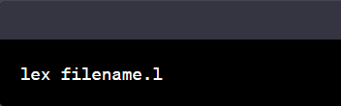
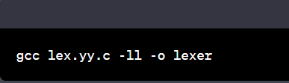
4. Type the following command in the terminal to generate the lexer:
This will generate a `lex.yy.c` file in the same directory as the `.l` file.
5. Compile the generated `lex.yy.c` file using a C compiler. For example, if you have the `gcc` compiler installed, you can use the following command to compile the generated file:
This will generate an executable file named `lexer`.

Slide 14
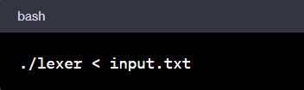
6. Execute the lexer by running the `lexer` executable file, passing input to be analyzed through the standard input (stdin) or through input redirection. For example, if you want to analyze a file named `input.txt`, you can use the following command:
This will execute the lexer and analyze the contents of the `input.txt` file.

Slide 15
Conclusion…
In conclusion, the auto-generation of C code from pseudocode is a useful technique that can save programmers a significant amount of time and effort. By using specialized tools or programming languages, developers can easily convert pseudocode into efficient and reliable C code that can be used to build complex software applications. This process not only helps in reducing the development time but also ensures the accuracy of the code, as it eliminates the possibility of human errors during the manual conversion of pseudocode to C code.

Slide 16
Thank You!

